Slide 1


Slide 2
Data Collection
IMDB website (Web Scraping)
Two Kaggle Datasets(csv):
My Anime List
Anime Planet

Slide 3
Difficulties faced while collecting the data
Null Values in the data(IMDB)
While scrapping some titles of the Anime were in Romaji and some were in English (Same problem was with the MAL dataset from Kaggle).
My Anime List (Scrapping was not allowed therefore took a Kaggle dataset for analysis).
Had to Collect data from different datasets and combined them.

Slide 4
Key Questions of Interest
What are the top genres and studios in Anime dataset?
Any Relation b/w Ratings and Votes?
IMDB vs MAL Ratings (Of 100 Animes)
What is the Average Ratings of Studios as per the no. of Animes produced?

Slide 5
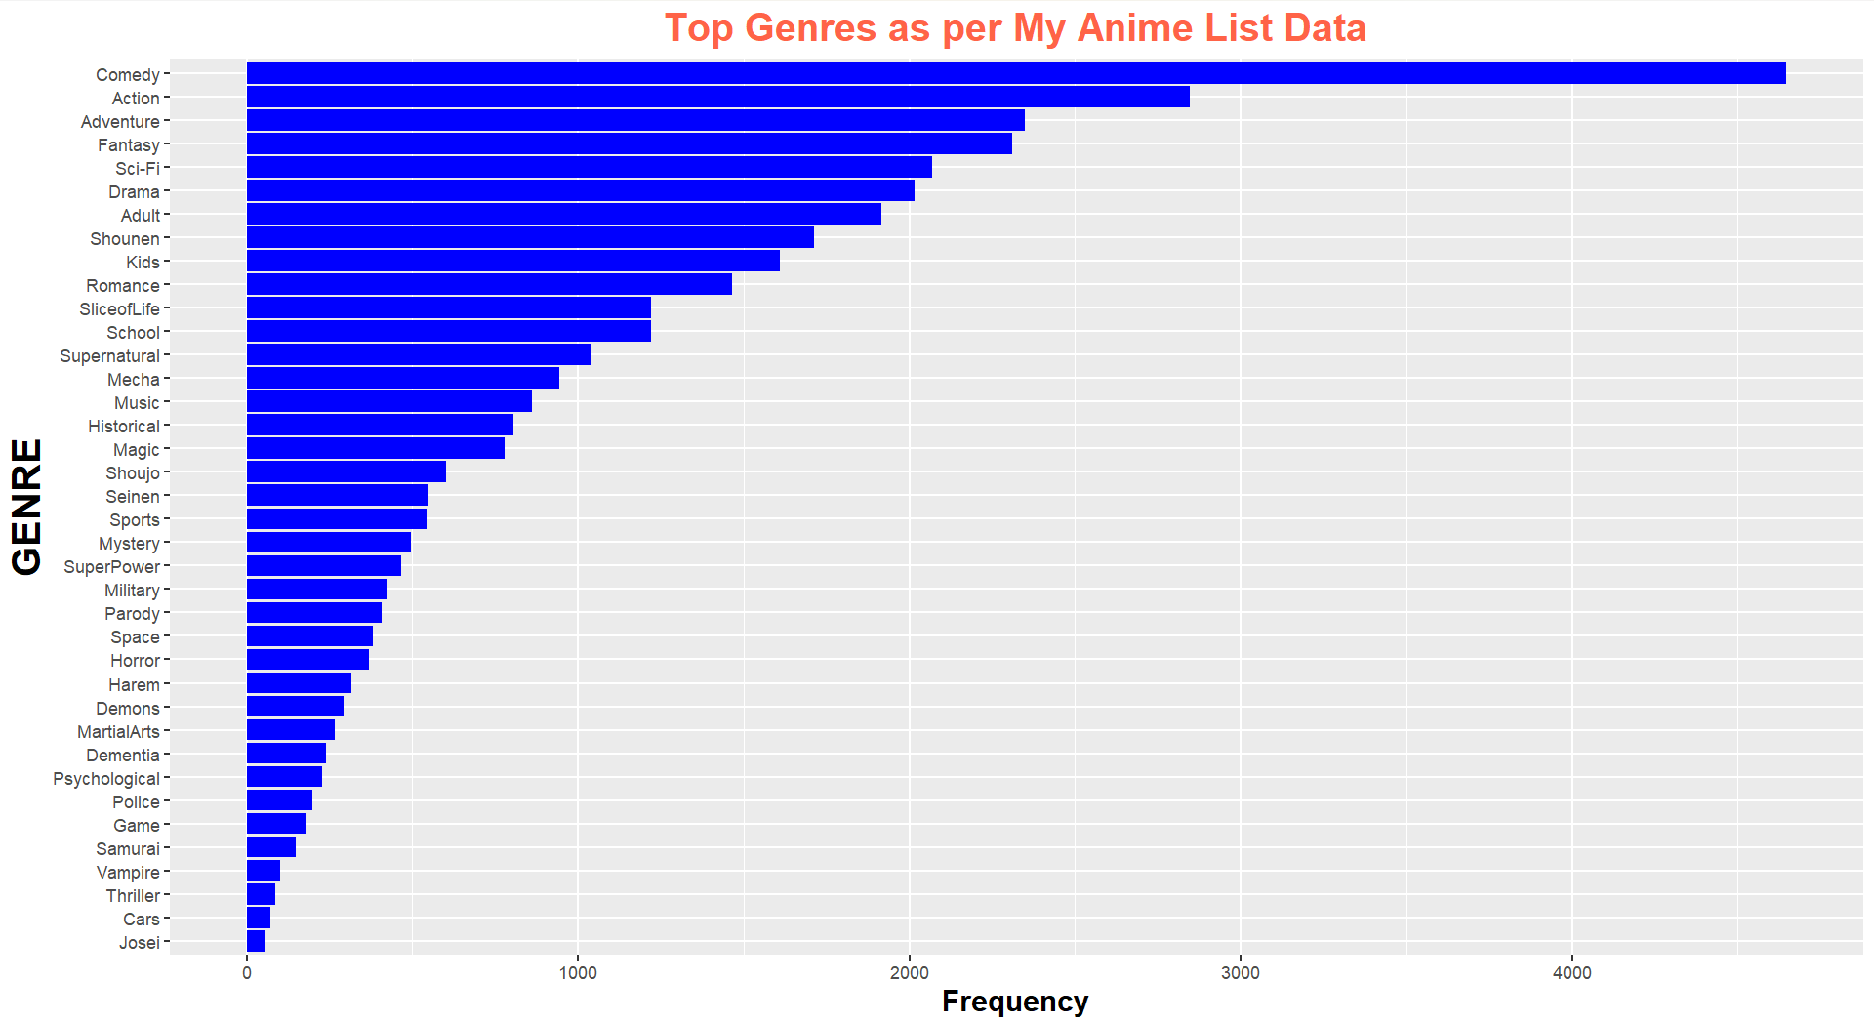

Slide 6
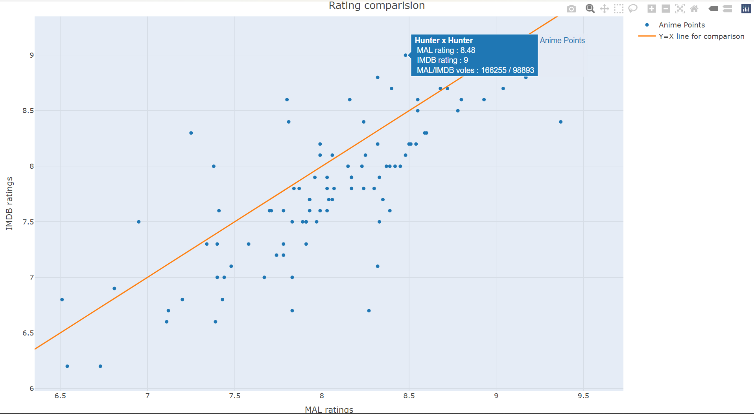

Slide 7
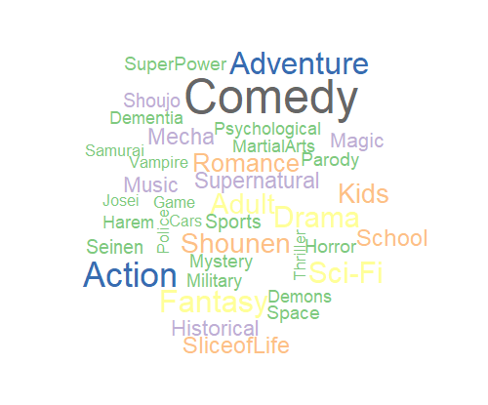
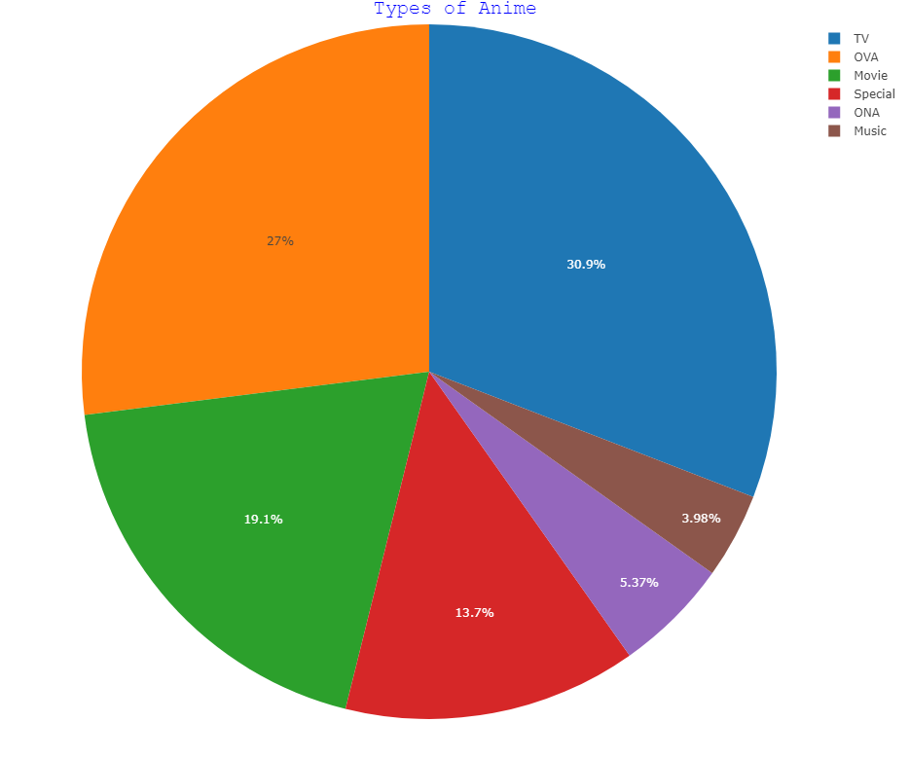


Slide 8
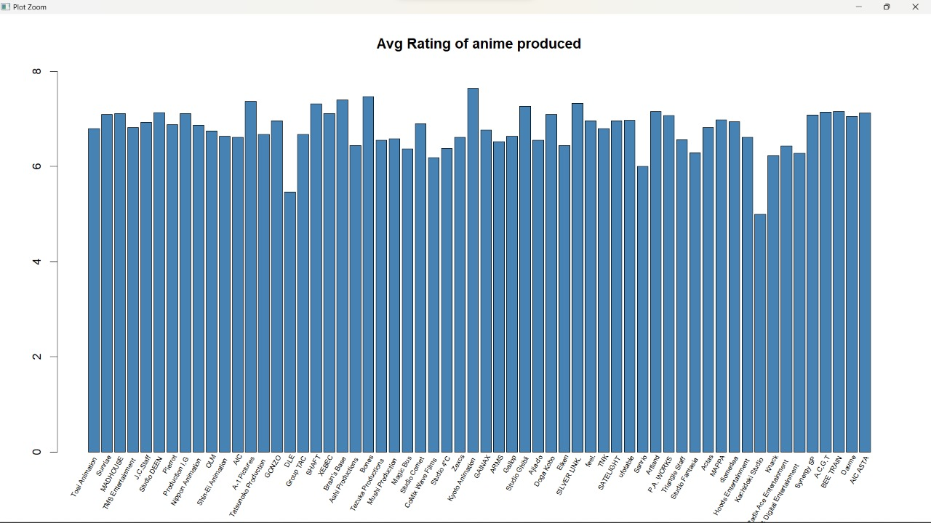

Slide 9
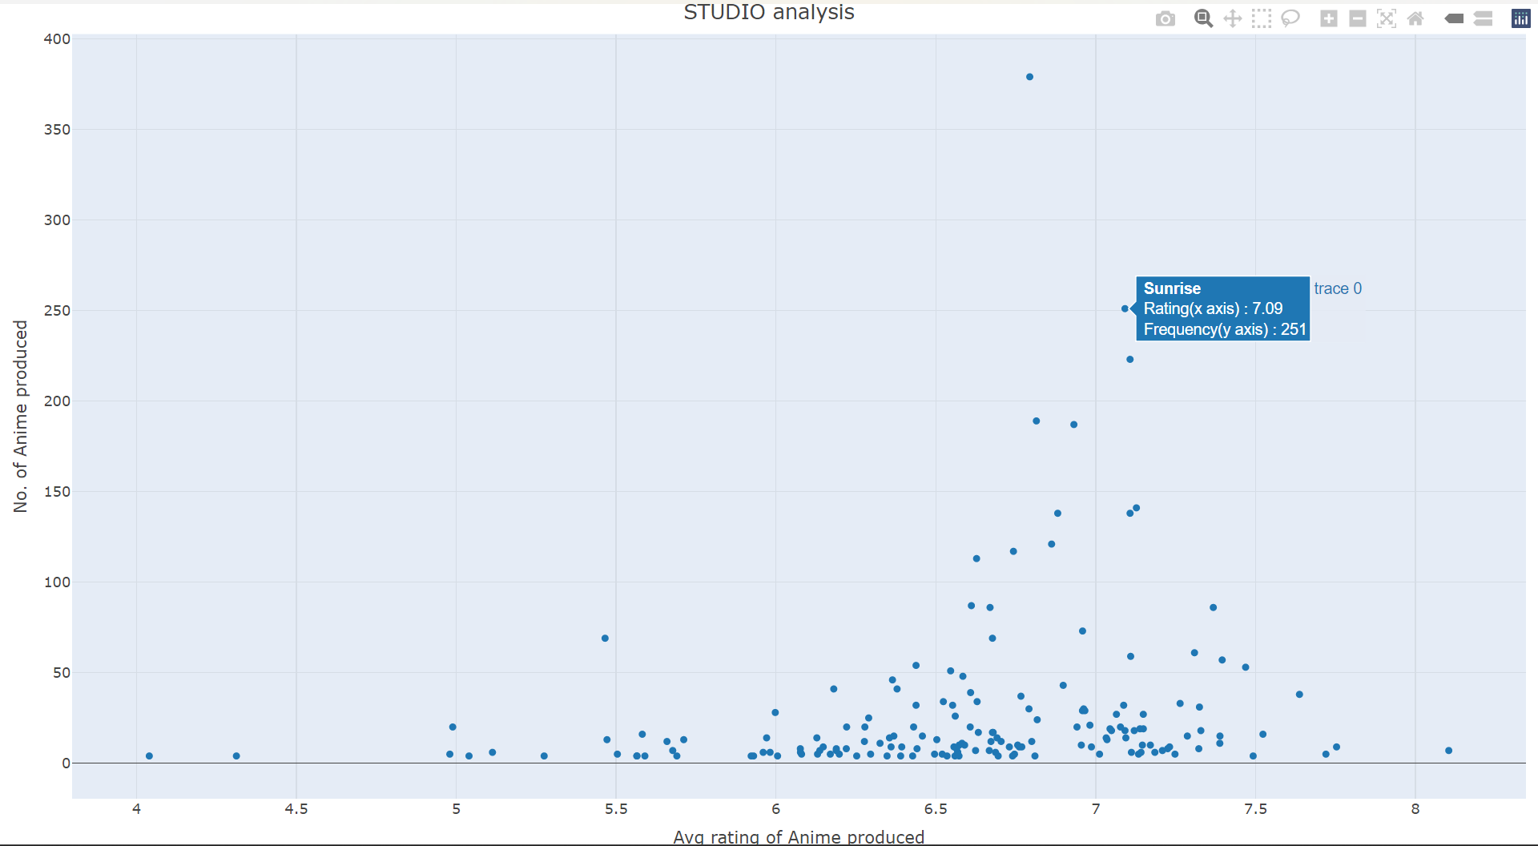
For plotting this we removed the studios which produced less than equal to three Anime so that
we could get a clear graph

Slide 10
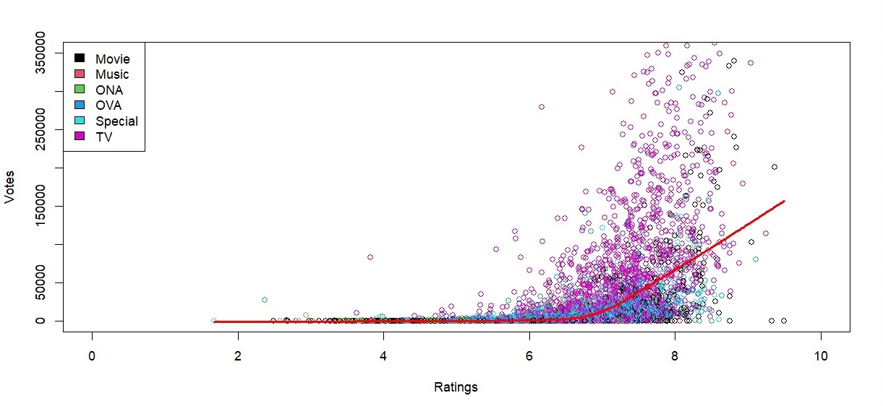
Best Fit curve of number of votes v/s ratings

Slide 11
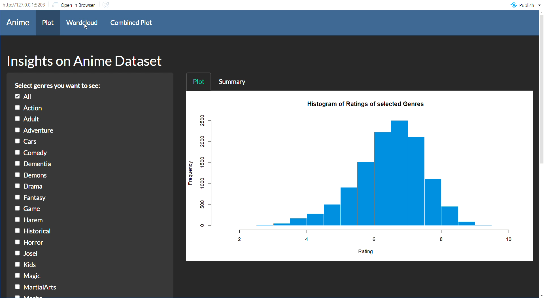

Slide 12
Some Insights From the data
Comedy, Action, Adventure, Fantasy, Sci-Fi are the top 5 common genres in the datast.
Generally it can be observed that as the no. of votes increases ratings also increases.
IMDB ratings of Anime are considerably less as compared to that of MAL.
Some of the top studios that produce anime (keeping in mind average rating and No. of Animes produced) are Madhouse, Sunrise, Toei Animation, J.C. Staff.
Through the best fit curve of scatter plot we observe that as the rating was around 7 there was an exponential increase in no. of votes.

Slide 13
THANK YOU
Group VI
Shabadpreet Singh (210954)
Dhairya Daga (221312)
Subhadra Kumari (221437)
Along Bar Mosahary (210103)

